Slide 1
Capstone Progress Report
Group 44: Andrew Soltesz, Mark Sprouse, Raja Petroff

Slide 2
Raja Petroff

Slide 3
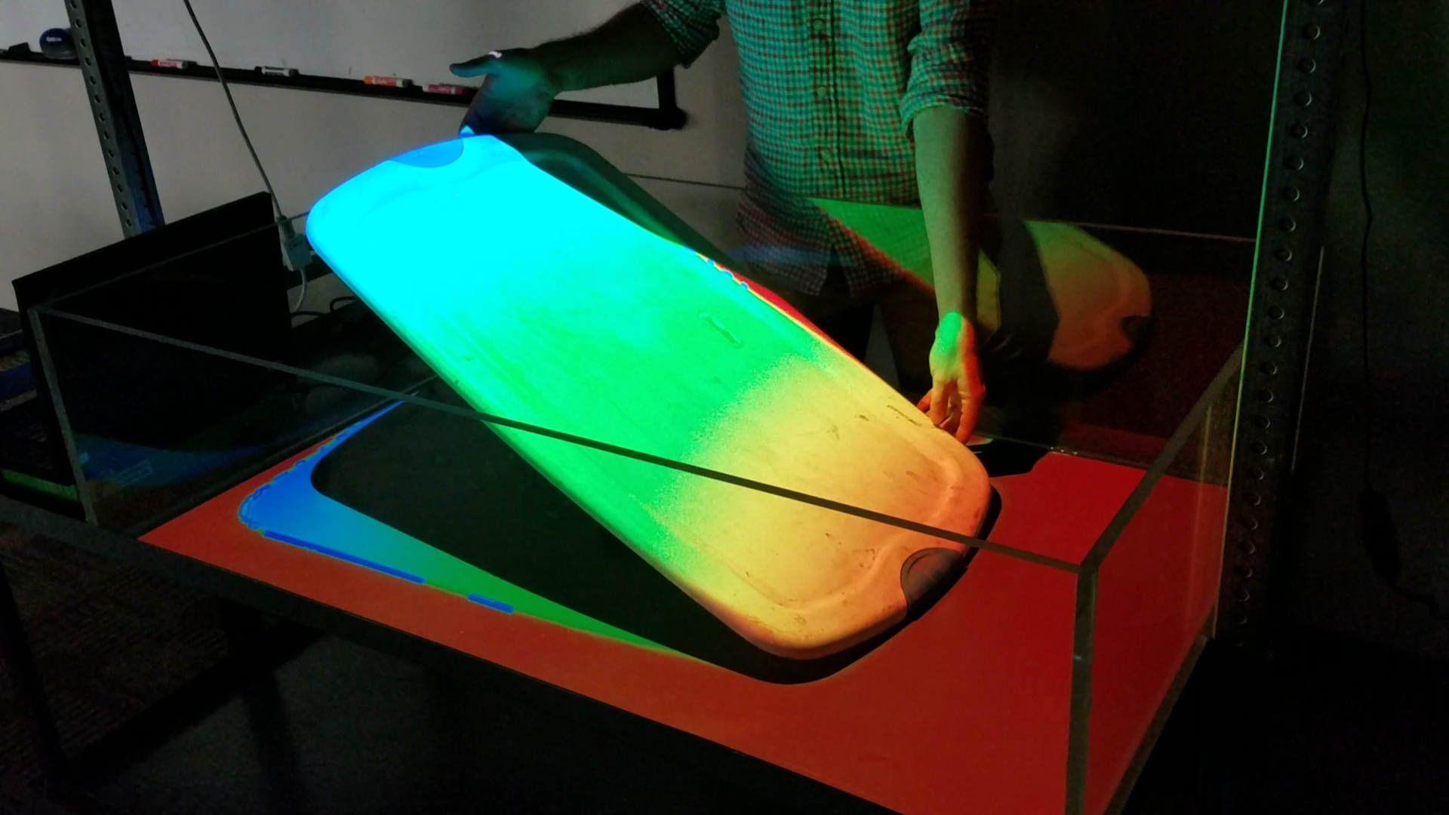
Project Recap
Project Purpose
Better collaboration and planning for engineers
Teach students cut and fill concepts
Project Goals
Augmented Reality sandbox
Manipulate terrain via sand
Visualize terrain
Road editing feature
Calculate cut and fill of road automatically
Our current AR sandbox. Testing depth mode.

Slide 4
Andrew Soltesz

Slide 5
Current Position
Terrain generation implemented
Triangle mesh
Updates in near real time
UI implemented
Unity UI system
Editable roads implemented
Cut/Fill mode implemented
Calibration mode implemented
Physical sandbox created

Slide 6
Mark Sprouse

Slide 7
Encountered Problems & Solutions

Slide 8
The Construction of the Box- Problem
Construction of Sandbox was directed primarily by client to 3rd party
We pressured for construction to happen as soon as possible, but some things are out of our control

Slide 9
The Construction of the Box- Solution
Continued development for the software of the system
Tested anything with a static, dummy test image on the system
Were unable to completely test anything because we did not have the sandbox as input to the system

Slide 10
Projector Mounting- Problem
Projector image is shifted up
Projector projects “up”
With Vertical positioning, it is shifted off

Slide 11
Projector Mounting- Solution
Alternate mounting options needed to be implemented
Instead of mounting projector onto central beam
Different plank is extended from central plank which offsets the projector from the center

Slide 12
Scheduling meeting times- Problem
With this term’s class schedules, the majority of meeting times conflict with at least one person
Most available time for all of us used to meet with client
Wanted to demo progress thus far and get input on directions we are headed

Slide 13
Scheduling meeting times- Solution
Additional online meetings were used to discuss things when people were not able to physically meet up
Less-ideal times and shorter meeting lengths were used to get as much meeting time as we could get

Slide 14
Illness and Other classwork- Problem
Everyone got ill at least once from cold weather or general school reasons
Everyone had a period of time where they were swamped with additional schoolwork and unable to find time for the sandbox

Slide 15
Illness and Other classwork - Solution
Made everyone’s work as self-contained as possible to reduce dependencies
Were able to assist others if they requested it
Entered into some “crunch-times” to compensate and get work done in the same amount of time
Not much we can do to prevent but can react as best we can

